Slide 1
Gastric Secretions
By Anmol Vashisht

Slide 2
Gastric Secretions
HCl
Pepsinogen
Mucus
Intrinsic Factor

Slide 3
HCl Secretion

Slide 4
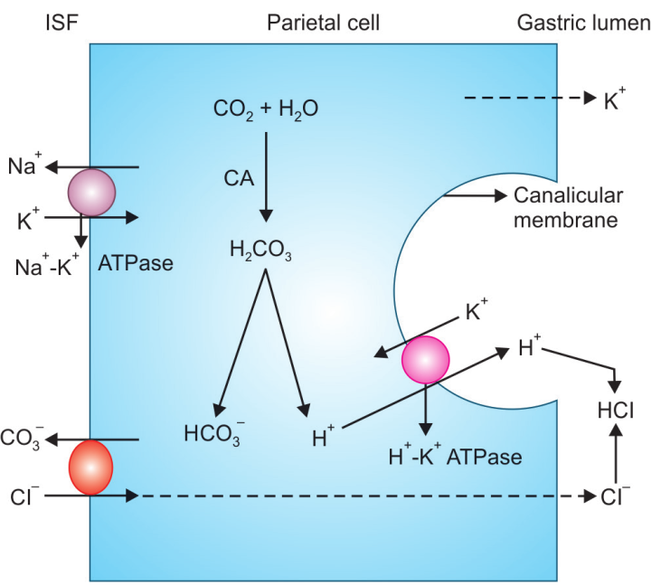
Secretion of HCl
HCl is secreted by parietal cells
H⁺ + Cl⁻ ====> HCl
Procurement of H⁺
Procurement of CO₂
Procurement of H₂O
Formation of H₂CO₃ (Carbonic Anhydrase)
Breakdown of H₂CO₃
Recycling and procurement of K⁺
Procurement of Cl⁻

Slide 5
Pepsinogen Secretion

Slide 6
Secretion of Pepsinogen
Pepsinogen is secreted by chief cells
It is synthesized in the cell like other proteins and stored in the zymogen granules
Types:
Type-I pepsinogen: Found in chief cells in fundus of stomach
Type-II pepsinogen: Found in chief cells in throughout the stomach

Slide 7
Mucus Secretion

Slide 8
Secretion of mucus
Mucus is secreted by mucus secreting cells plentily available in the neck region of the gastric glands
Types:
Soluble mucin: Secreted by mucus secreting cells of entire gastric mucosa
Insoluble mucin: Secreted from mainly cardiac and pyloric mucosal cells
Function:
Mucin forms a protective layer on the gastric epithe­lium and protects the lining of the stomach from the corrosive action of HCl

Slide 9
IF Secretion

Slide 10
Secretion of Intrinsic Factor(IF)
Intrinsic factor (IF) is a glycoprotein
It is secreted from parietal cells along with HCl.
Function:
Helps in vitamin B12 absorption

Slide 11
Q&A

Slide 12
Thank You

